Slide 1
Sprint 4 Group 1 output

Slide 2
OPEN MINDED KA BA?

Slide 3
Problem Statements
Organizing through social media (twitter):
Are there signs of Echo chambers within a community ?
Are there clear parallels to the top leading election candidates in terms of how they advocate for their side ?
Can we identify twitter sentiments with regards to the top candidates of the upcoming 2022 elections ?
Which candidate communities are open minded ?
How open-minded are the supporter communities of the 2022 presidential candidates in terms of listening to opinion outside of their respective communities?

Slide 4
Hypothesis
Influencers(not necessarily campaigners)/bridge nodes of each candidate are different
Similar words and phrases throughout each candidate supporter
We scrape words in order to check whether they are supporters or non supporters
Communities other than Robredo or Marcos supporters are more likely open-minded.

Slide 5
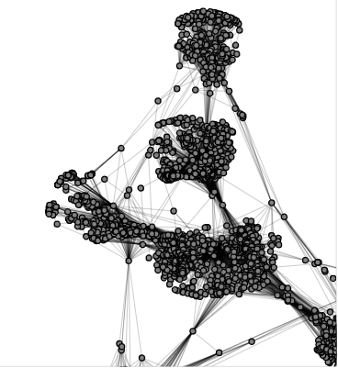
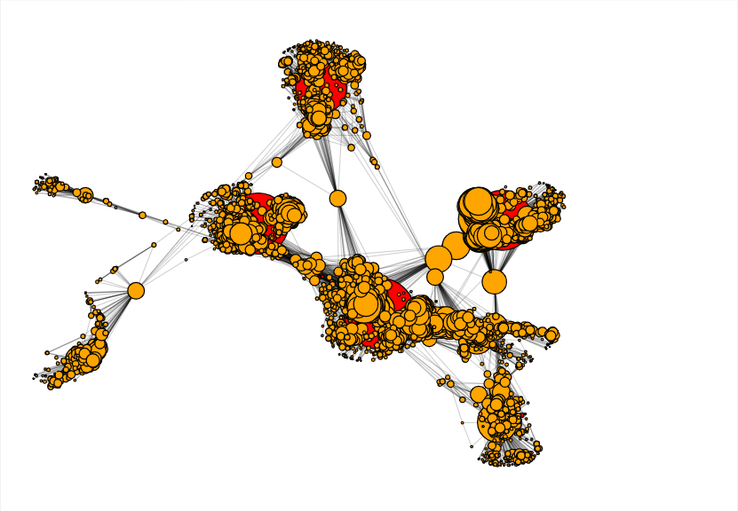
Network
Edge: Engagement (RT, replies,mention)
Edge: Follows

Slide 6
Methodology
Tweetpy
Hashtags that trended IN THE PAST WEEK
hashtag that each campaign specifically uses
Hashtag towards a candidate
Tagging as supporter or not based on average sentiment score x
Nodes
Twitter Users
Edges
Follows
Scrape data with twint/twitter API
Map out the twitter network
Identify communities per candidate (Girvan-Newman)
Identify influential supporters(Degree)
Scrape tweets using hashtags
Hashtags chosen
Sentiment analysis to determine affiliation
Measure community open-mindedness based on the influencers(measurement pending)

Slide 7
xx%
Use this slide to show a major stat. It can help enforce the presentation’s main message or argument.

Slide 8
Flow:
Intro/background
Problem
Importance of what we are doing
How it was done
Result
Feedback
1)add limitations(no. tweets, non inclusion of candidates)
2)label histogram + distribution fit + combine in one slide
3)centrality measure for candidates, play around with the number of communities(girven-newman)
4)topic modeling or bar chart > word cloud
5)add some slides to connect the problem, explain networks and concepts quickly

Slide 9
OPEN MINDED KA BA?
1delaCruz: Nico Grace Ale Adrian
Notes:
Analyzing the network of presidential candidate communities

Slide 10
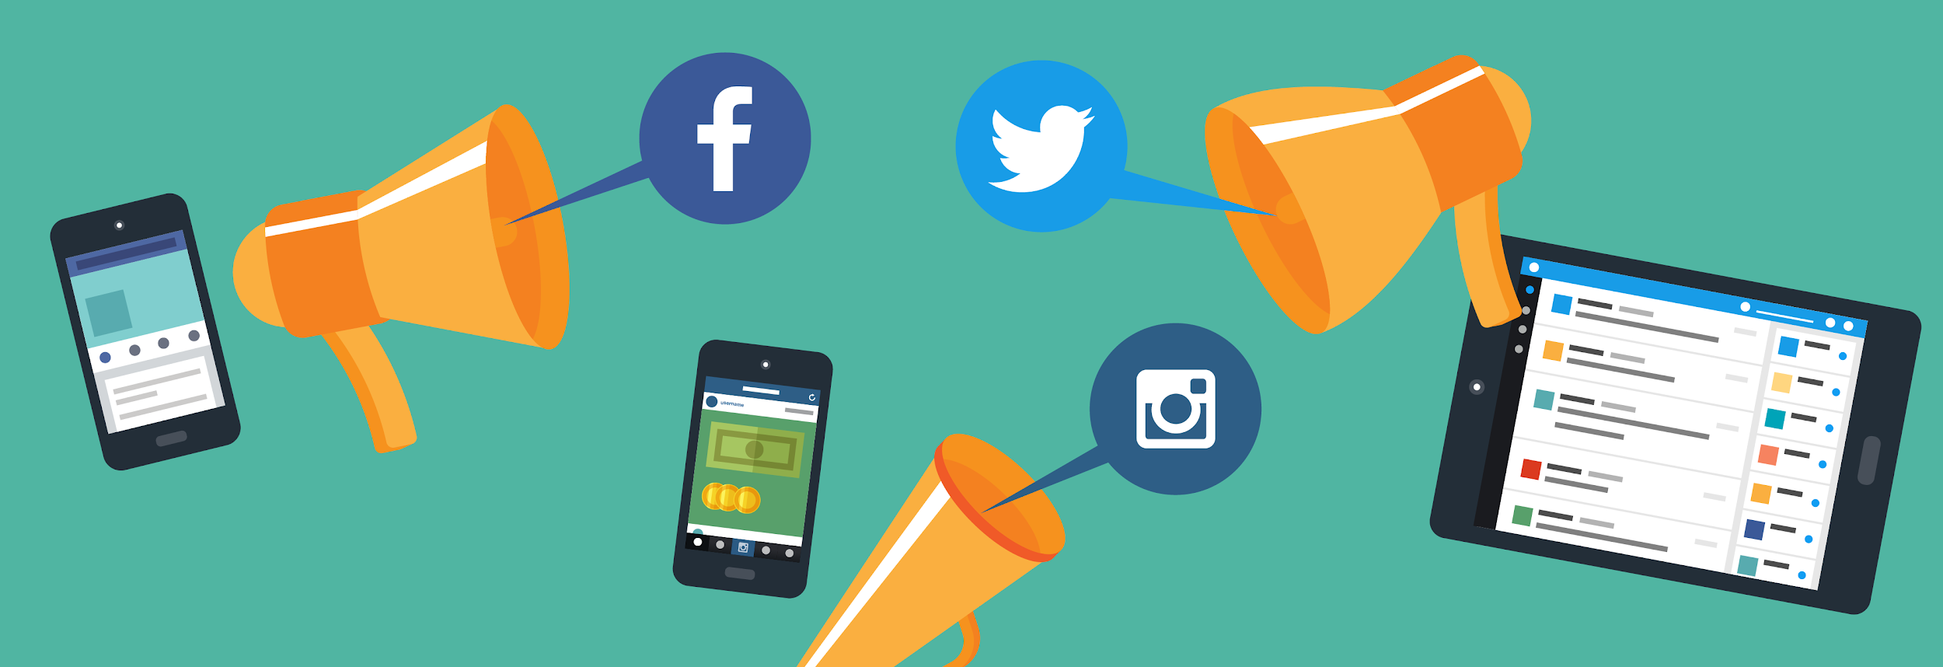
#Halalan2022
Notes:
So as we know, elections is coming up. Social media platforms like twitter play a big role in facilitating discussions. However, these discussions are not always fruitful. For a beginner, they could be overwhelmed by the toxicity and mudslinging. For current users, it’s important to be aware of echo chambers and try to break out of them.
As such, we will examine how open minded the communities of the top candidates and the topics discussed to give people a bigger picture and a chance to sift through the chaos.

Slide 11
Do candidate communities stay within their respective communities ?
We want to guide people to see a bigger picture of the election landscape on twitter
Notes:
So as we know, elections is coming up. Social media platforms like twitter play a big role in facilitating discussions. However, these discussions are not always fruitful. For a beginner, they could be overwhelmed by the toxicity and mudslinging. For current users, it’s important to be aware of echo chambers and try to break out of them.
As such, we will examine how open minded the communities of the top candidates and the topics discussed to give people a bigger picture and a chance to sift through the chaos.

Slide 12

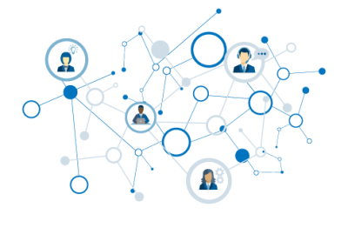


METHODOLOGY
From all the users that tweeted, scraped following list from a sample of users
Scrape tweets from twitter with supportive hashtags from Jan 19-28
Mapped out a social media network from scraped user information
Analyzed the network based on network science metrics
Google translated 200 tweets for each candidate and used topic modelling
Leni: #LeniAngatSaLahat, #LetLeniLead, #Kakampink, #LabanLeni
Isko: #KayIskoPosible, #TunayNaSolusyonMabilisUmaksyon, #NaIsko,#IkawNaIsko
BBM: #GoBBM, #BBM2022, #BBMIsMyPresident2022,
Lacson: #KakamPING, #GwaPing, #PapaPing

Slide 13
LIMITATIONS
Scraped tweets for each support community is highly imbalanced, but this only reflects the reality of the distribution of supporters in twitter.
Pacquiao and Ka Leody support communities is excluded due to small dataset.
Google Translate was not able to interpret all words and nuances to English.

Slide 14
Why use if a user follows ____ as our basis?
“When you follow an account, you’ll see them on your following list and their Tweets will appear in your Home timeline. We’ll notify the person you follow, and you may even get a follow back.”
-Twitter
The main assumption is that if a user is following politician X or someone also following politician X, then the user wants to HEAR FROM politician X.

Slide 15
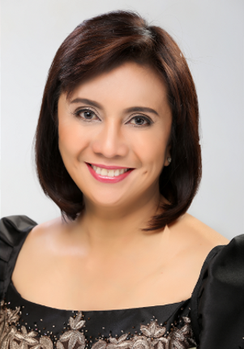
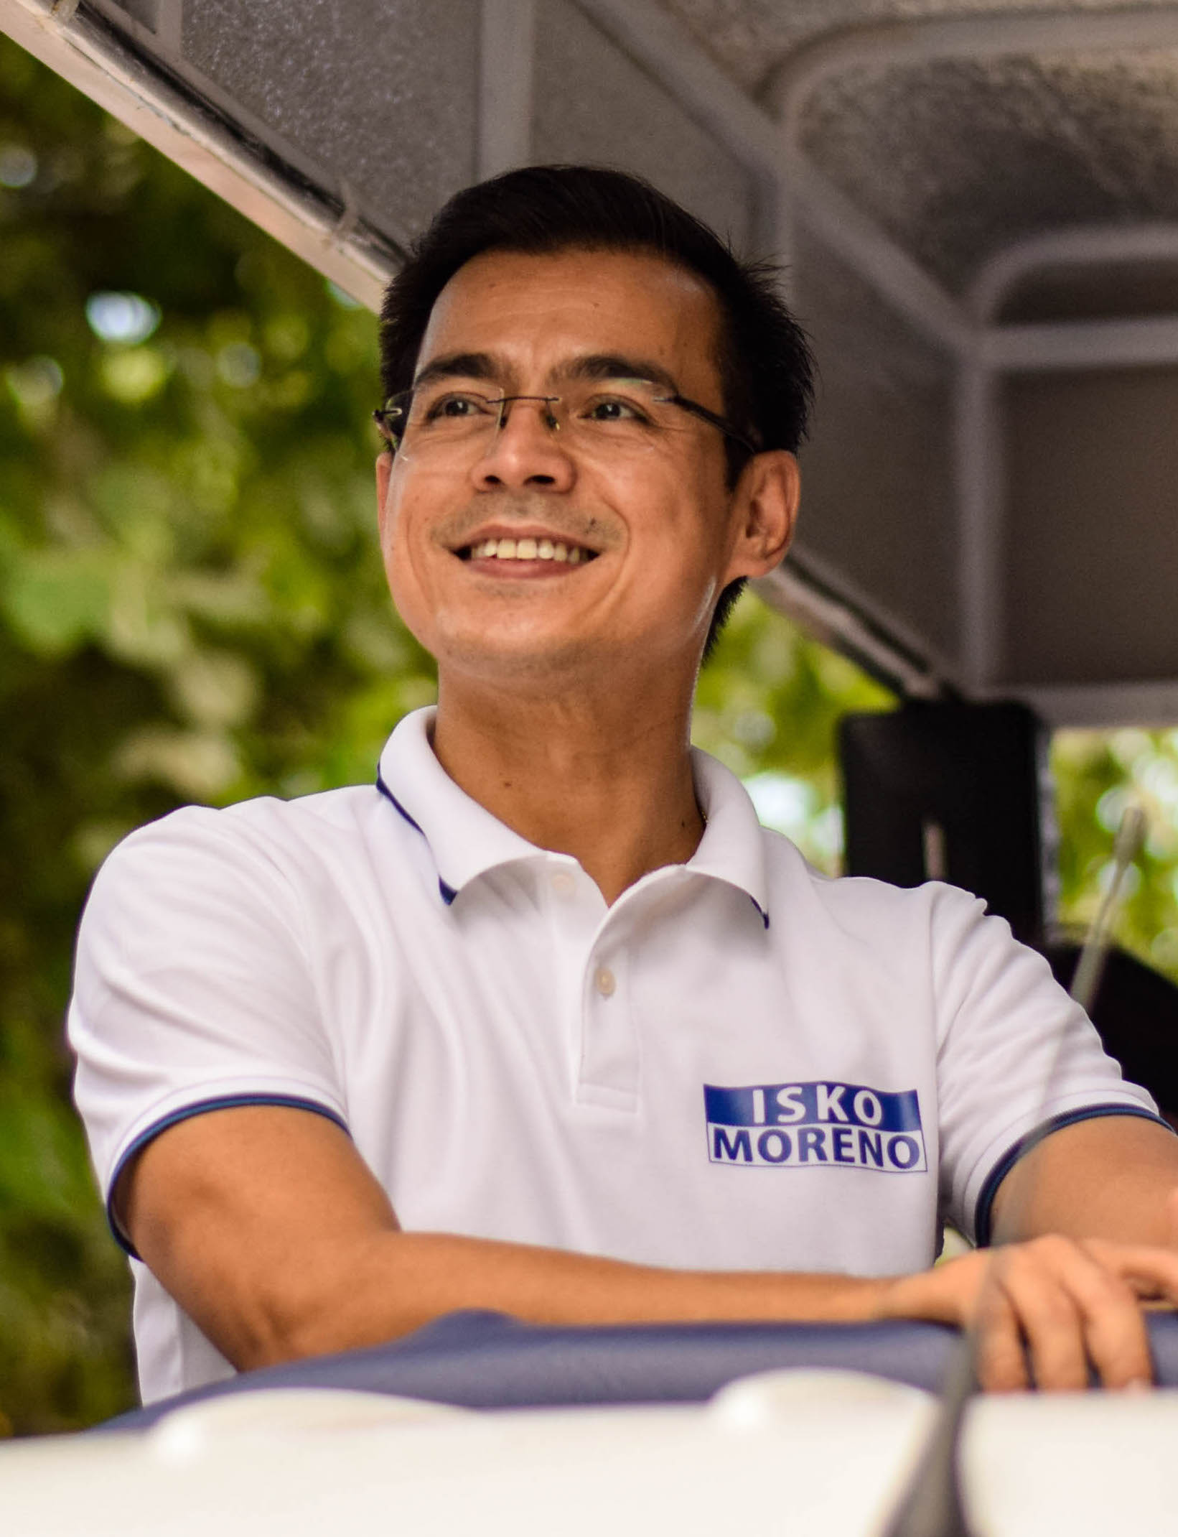
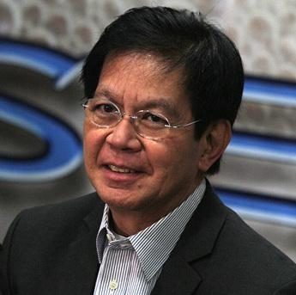
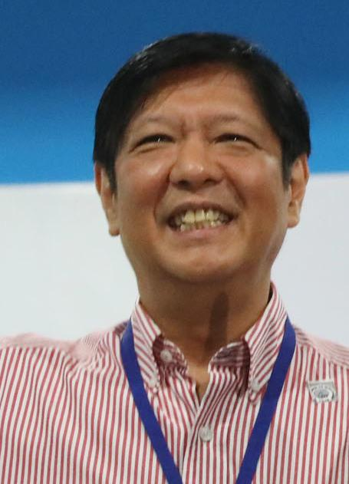
Network Analysis 101: Using ‘Follows’
Node: Candidate

Slide 16
U1
followed by

Slide 17
U2
U1
U3

Slide 18
U2
U4
U1
U3

Slide 19
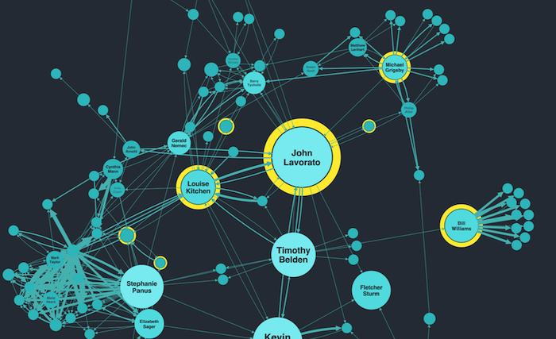

Slide 20
DATA SET & EDA
Notes:
What each community is saying(WORDCLOUD)
Describe headers of the df used in both
observations from the word cloud data set (common words, top phrases?, etc)?
Observations from followers data set ()

Slide 21


Scraped tweets based on the hashtags
BBM : 24430
ISKO : 1252
LENI : 48539
PING : 121
Scraped following list (Unique User)
BBM : 500
ISKO : 84
LENI : 500
PING : 51

Slide 22
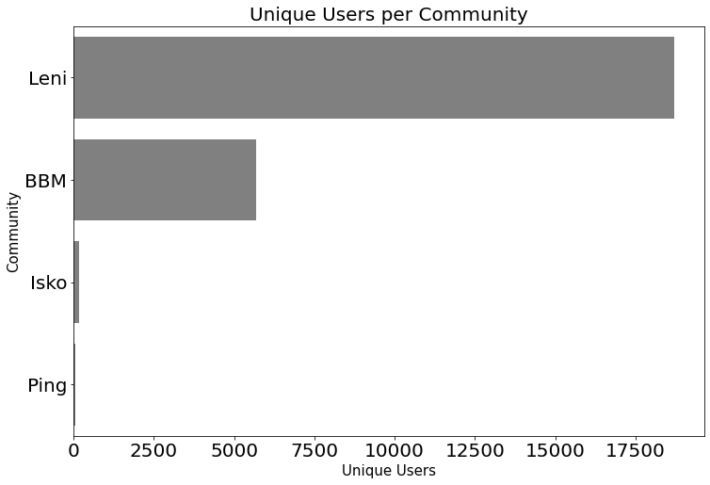
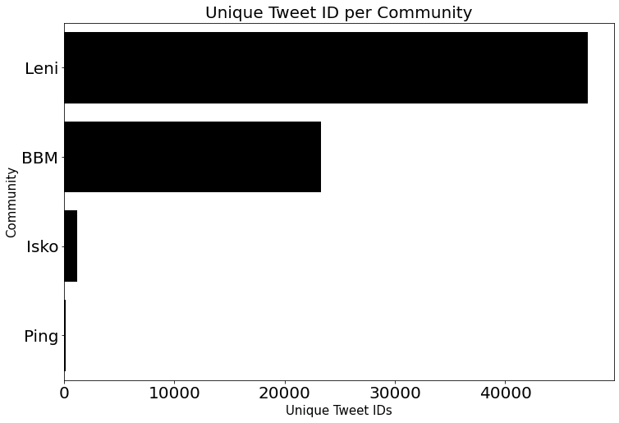
Leni’s community has the highest count in terms of unique users and unique Tweet ID

Slide 23
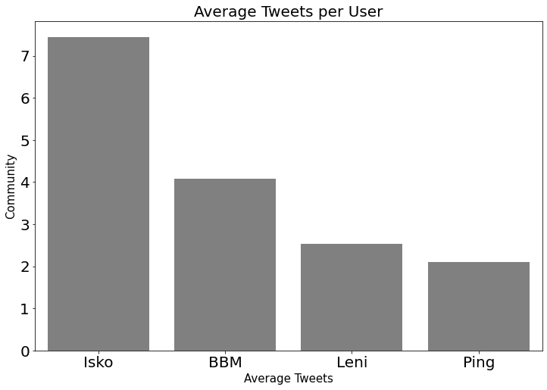
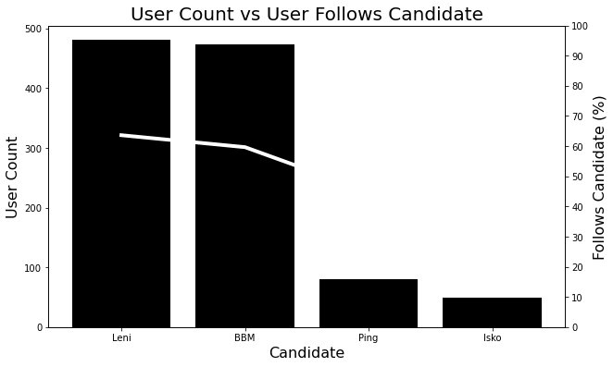
Isko’s community has the highest average tweets.
Relative to User Count,
Leni’s community follows their Candidate’s (Leni) official Twitter account the most.
Notes:
Woman, plan, sinungaling

Slide 24
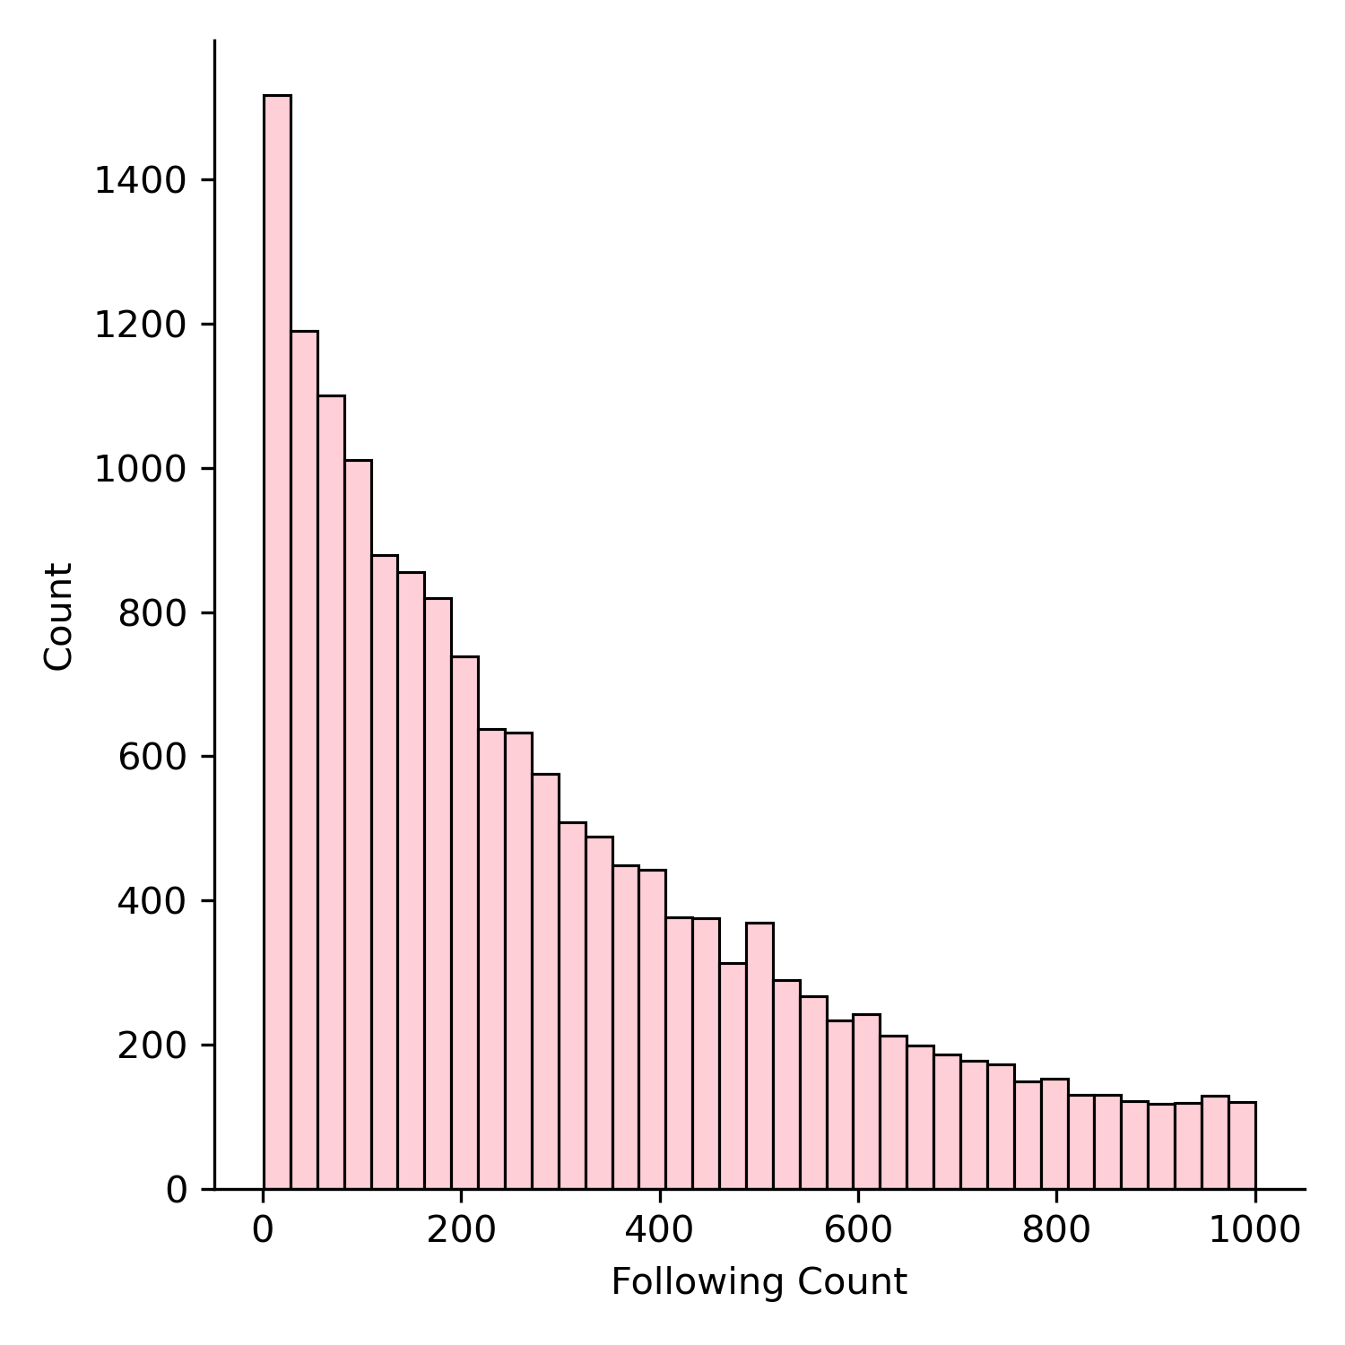
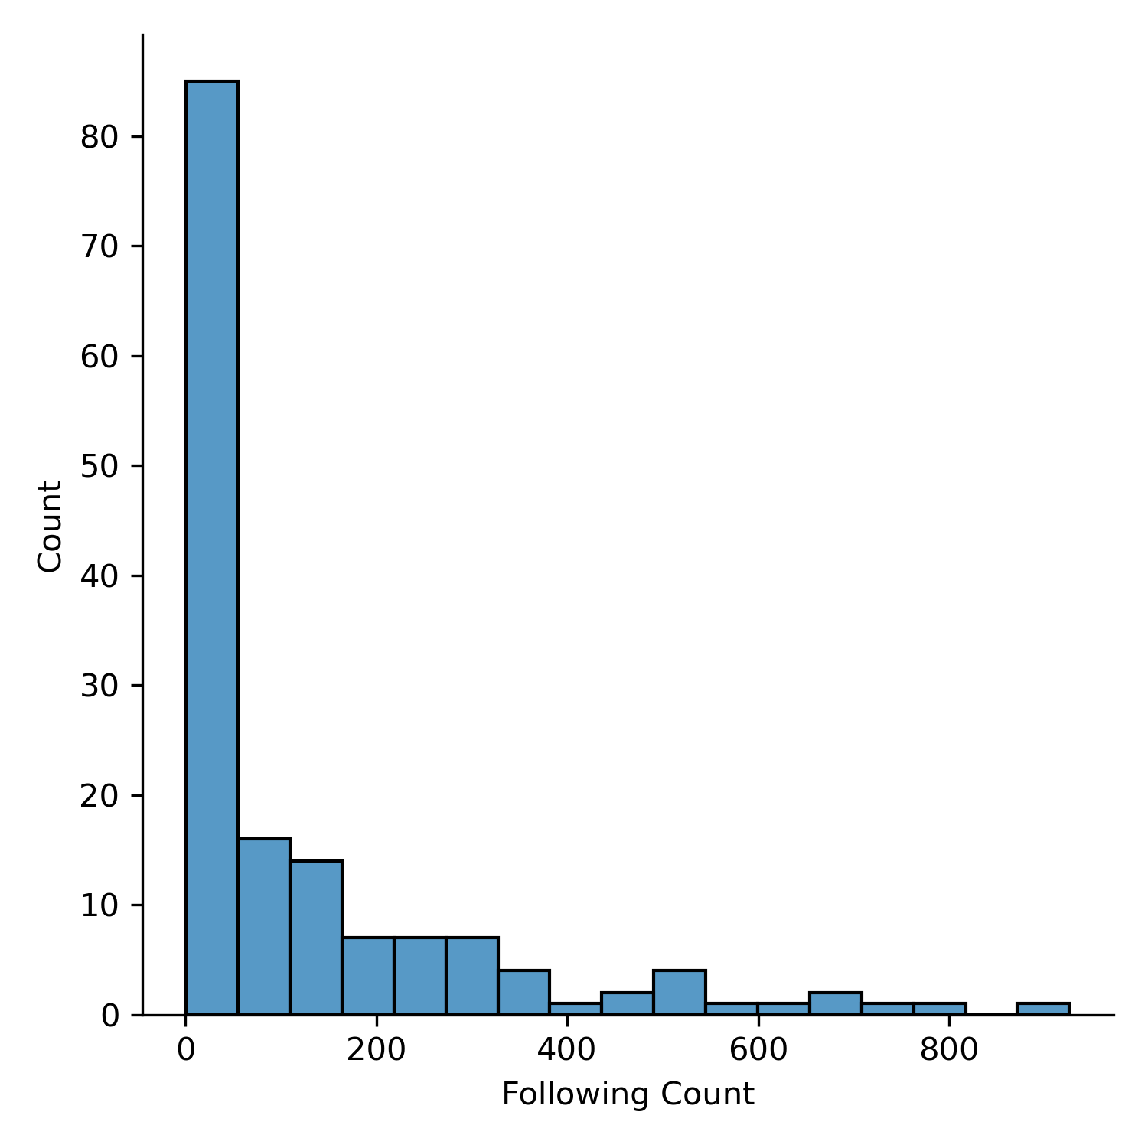
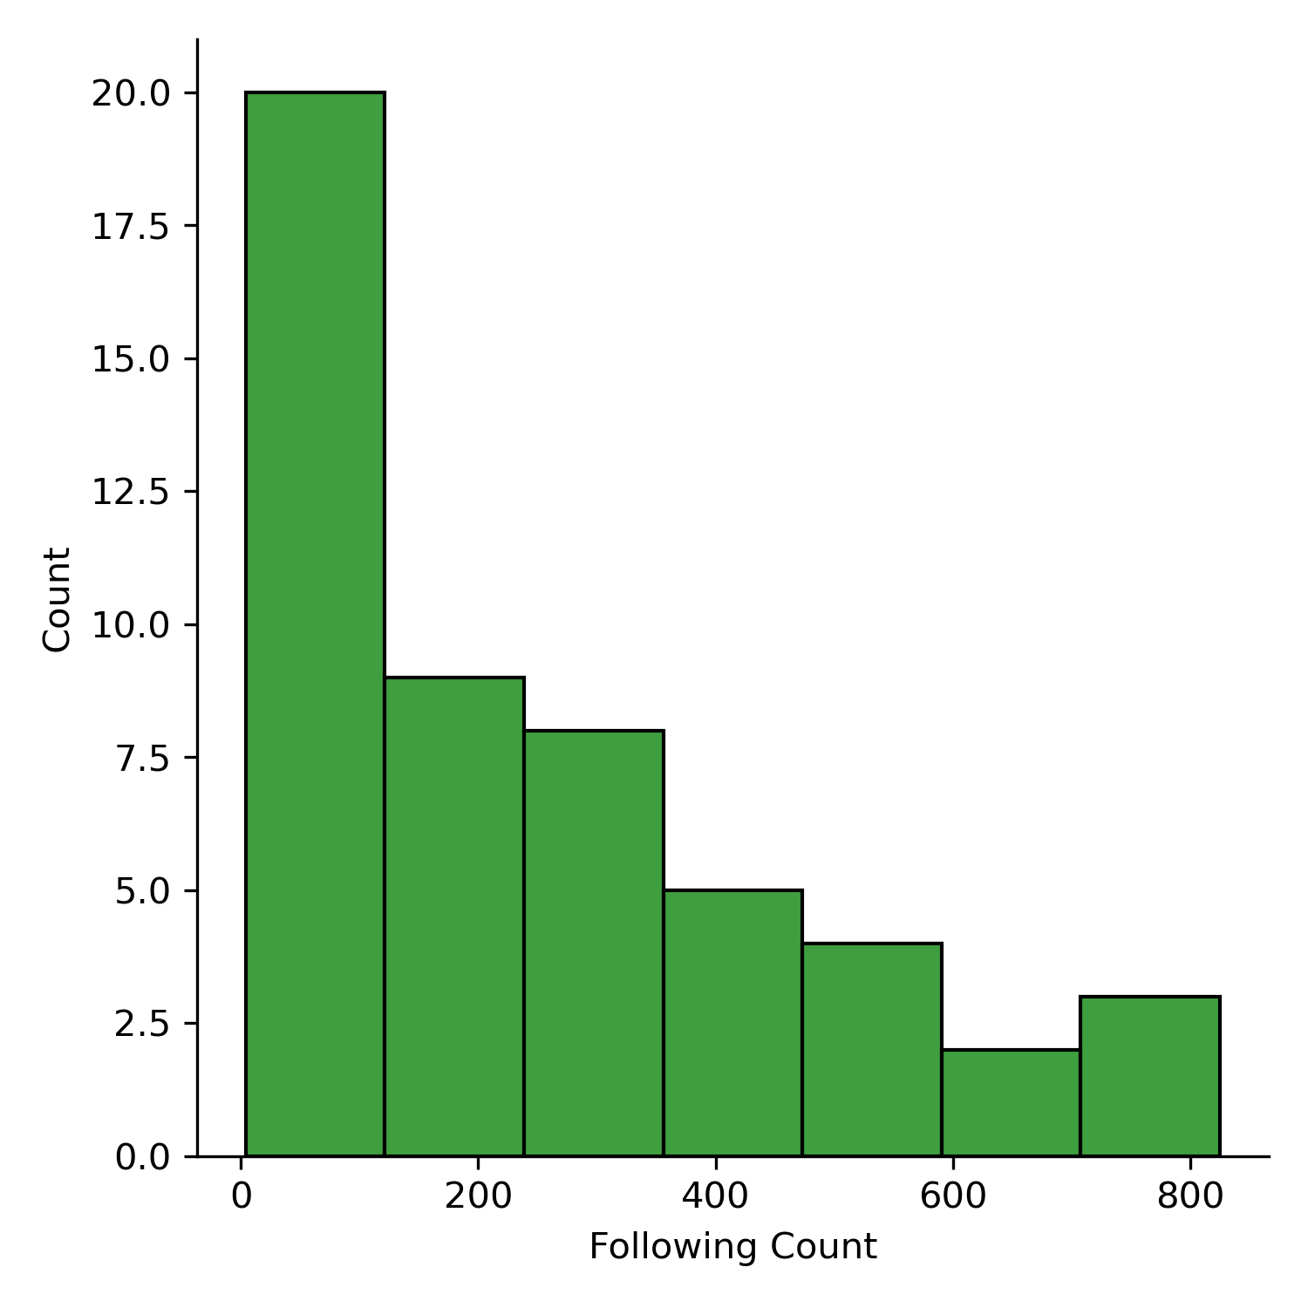
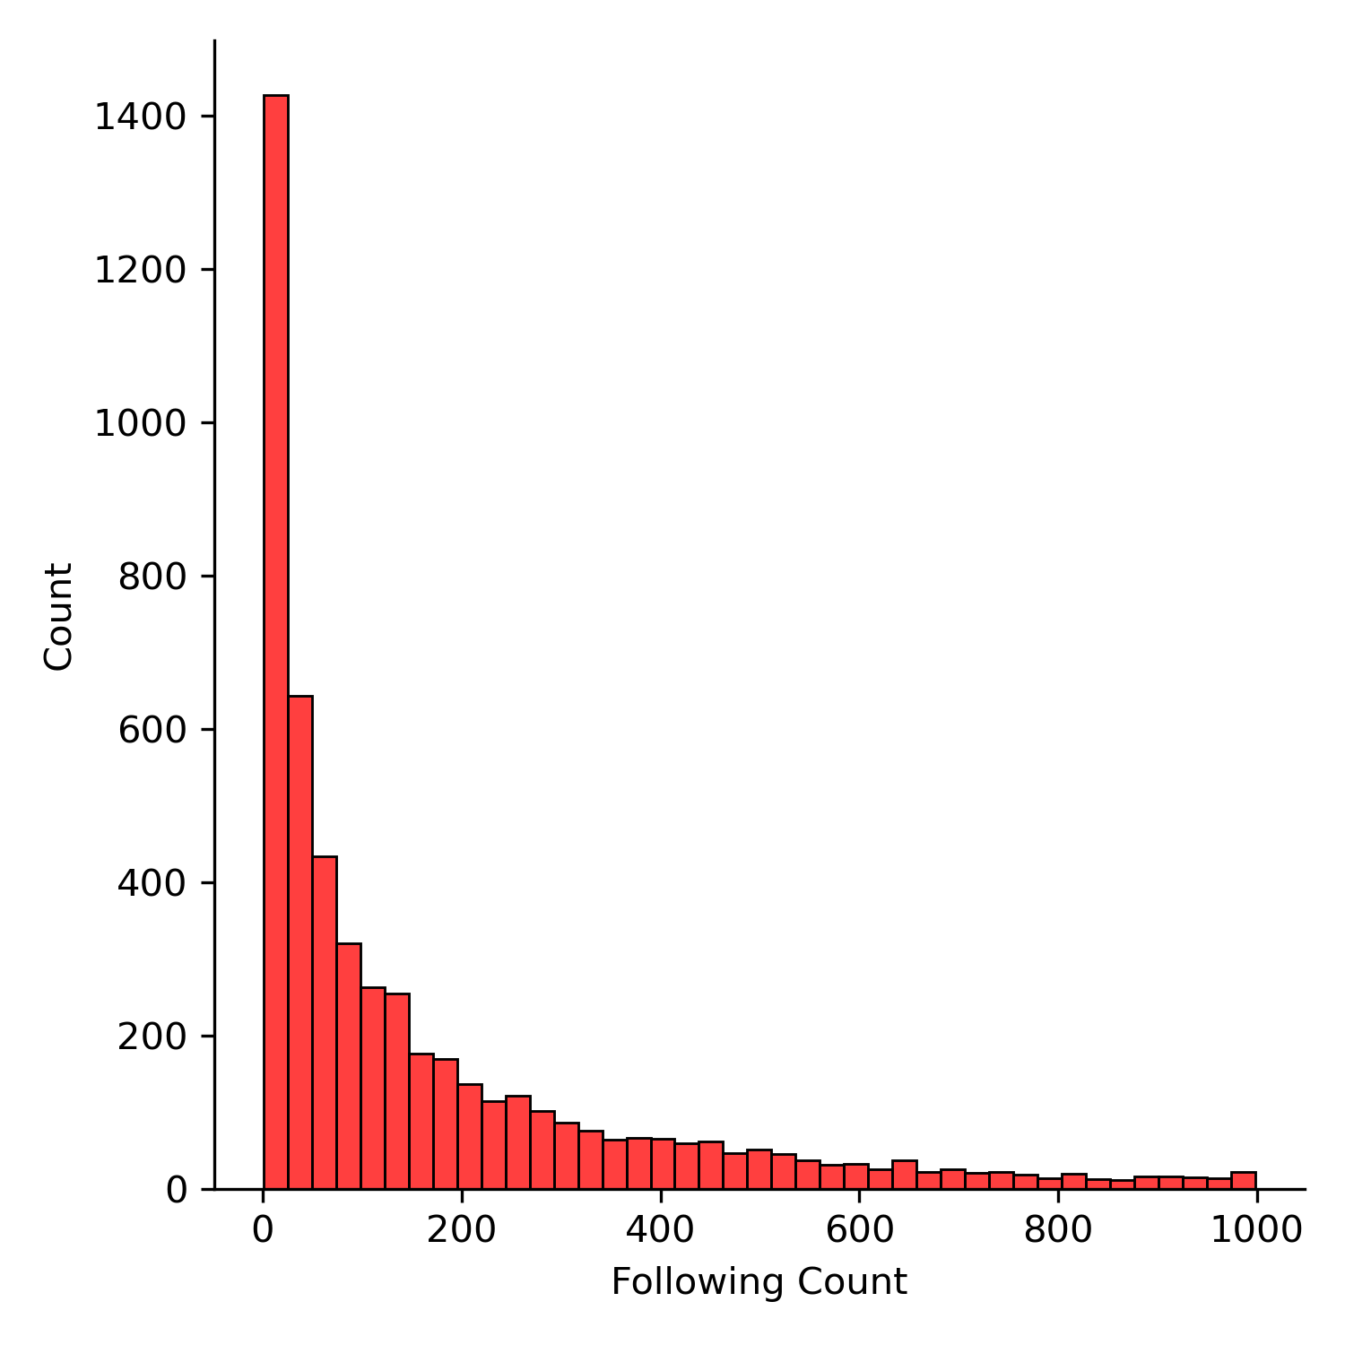
Most of the user’s following count ranges from 0-200.
Possibility that most accounts are newly created.
Comparing supporter Following Count

Slide 25
Topic Modelling

Slide 26

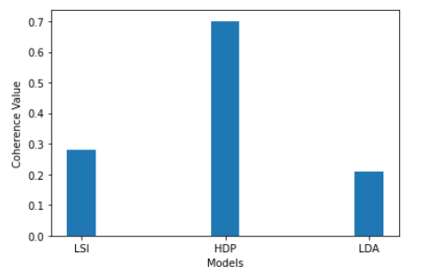
Topic Coherence
Hierarchical Dirichlet Processes
interpretability
https://giphy.com/gifs/ssm-songsongmeow-bysecond-bFhSvsdyaCy4g0d2lU
Notes:
HDP
-the model takes the tweets and uses a Dirichlet distribution to weigh the words and group them again as topics
-Dirichlet distribution is like a distribution of distributions, for example picking one six sided die from 100 dice
Topic Coherence
-this is a measurement of how interpretable the models are by looking

Slide 27
Attacks on BBM
Accountability
BBM
think
Weed Legalization
Marijuana
drug
policy
Character
brave
honest
humanga(admire)

Slide 28
Manila Mayor
Zoo
serbisyo(service)
Maynila
unahin(prioritize)
Political Dynasty
Ferdinand
dynasty
continue
Character
articulated
sacrifice
mabuti(good)

Slide 29
Covid
pandemic
health
prevention
Economy
economic
import
reform
Character
morality
experience
intelligent

Slide 30
Attacks on Leni
bitter
Leni
pinktard
Unity
people
pagkakaisa(unity/solidarity)
Pilipino
Legal Issues
understand
defend
investigation

Slide 31
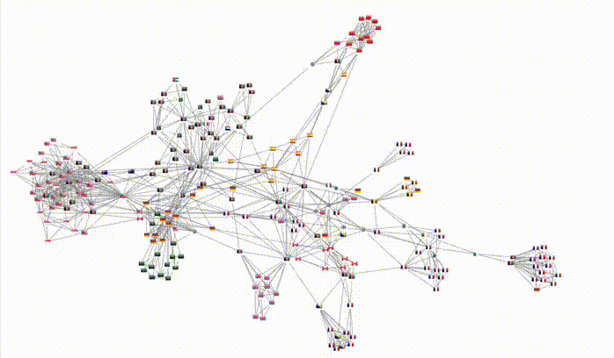
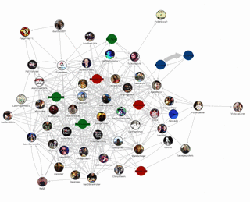
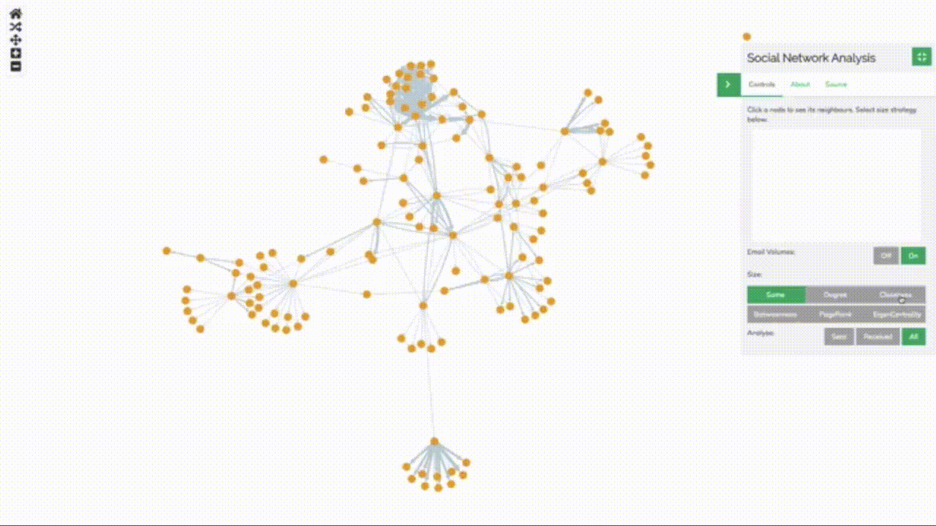
Local Centrality
Degree
Betweenness
Closeness
“peymus”
“marites”
“bestie”
https://cambridge-intelligence.com/keylines-faqs-social-network-analysis/
Notes:
Degree centrality - Used for finding very connected individuals, popular individuals, individuals who are likely to hold most information or individuals who can quickly connect with the wider network; identifying local leaders
Betweenness - Used for finding the individuals who influence the flow around a system; identifying the bridges
Closeness - Used for finding the individuals who are best placed to influence the entire network most quickly.

Slide 32
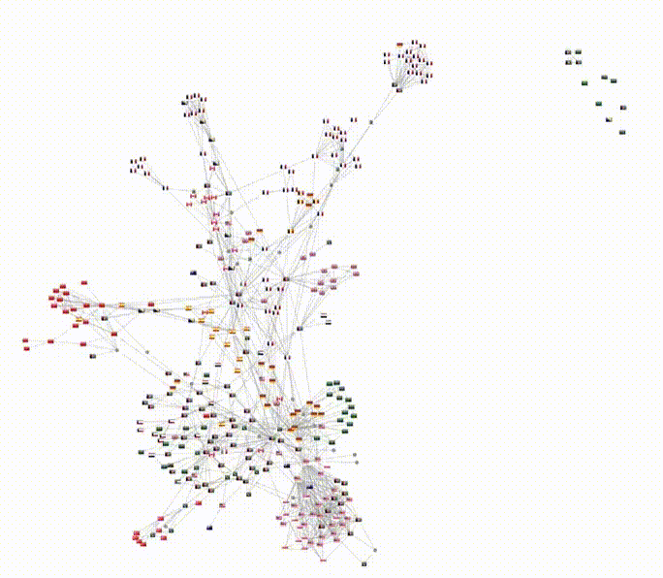
Community Detection
Girvan–Newman algorithm
https://cambridge-intelligence.com/keylines-faqs-social-network-analysis/
Notes:
Girvan Neuman - detects the community

Slide 33
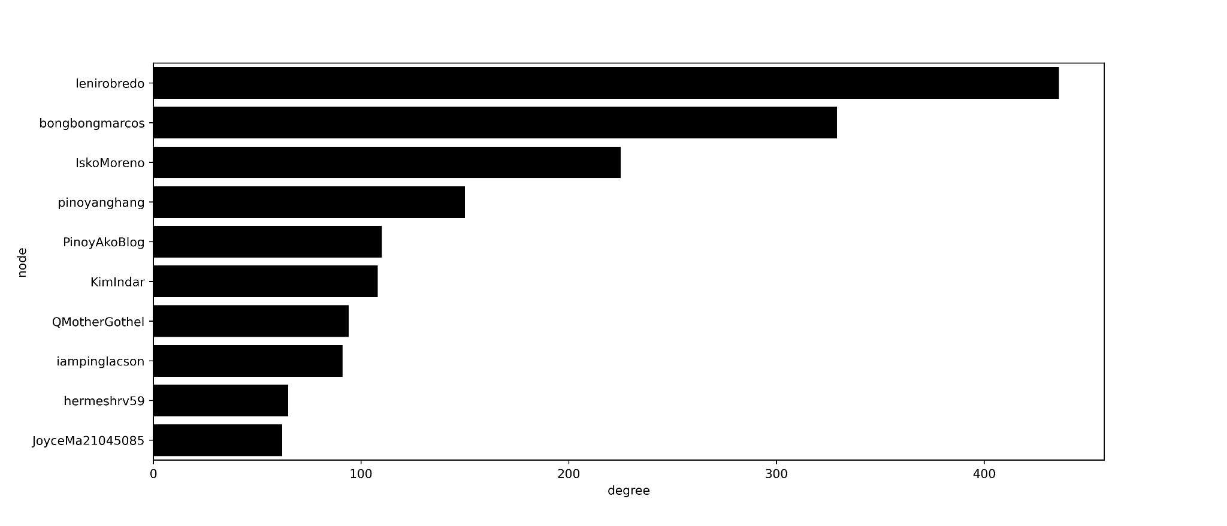
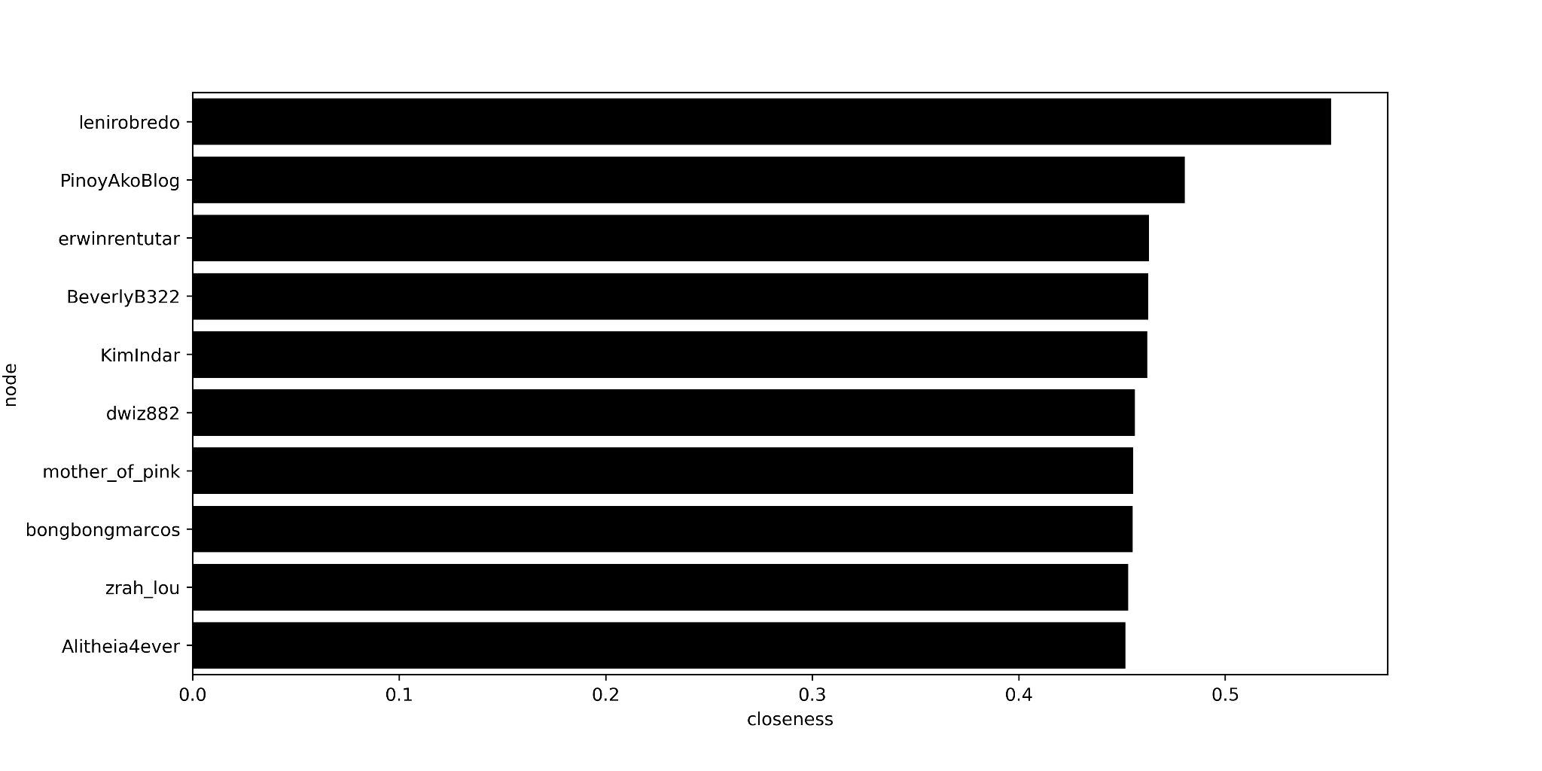
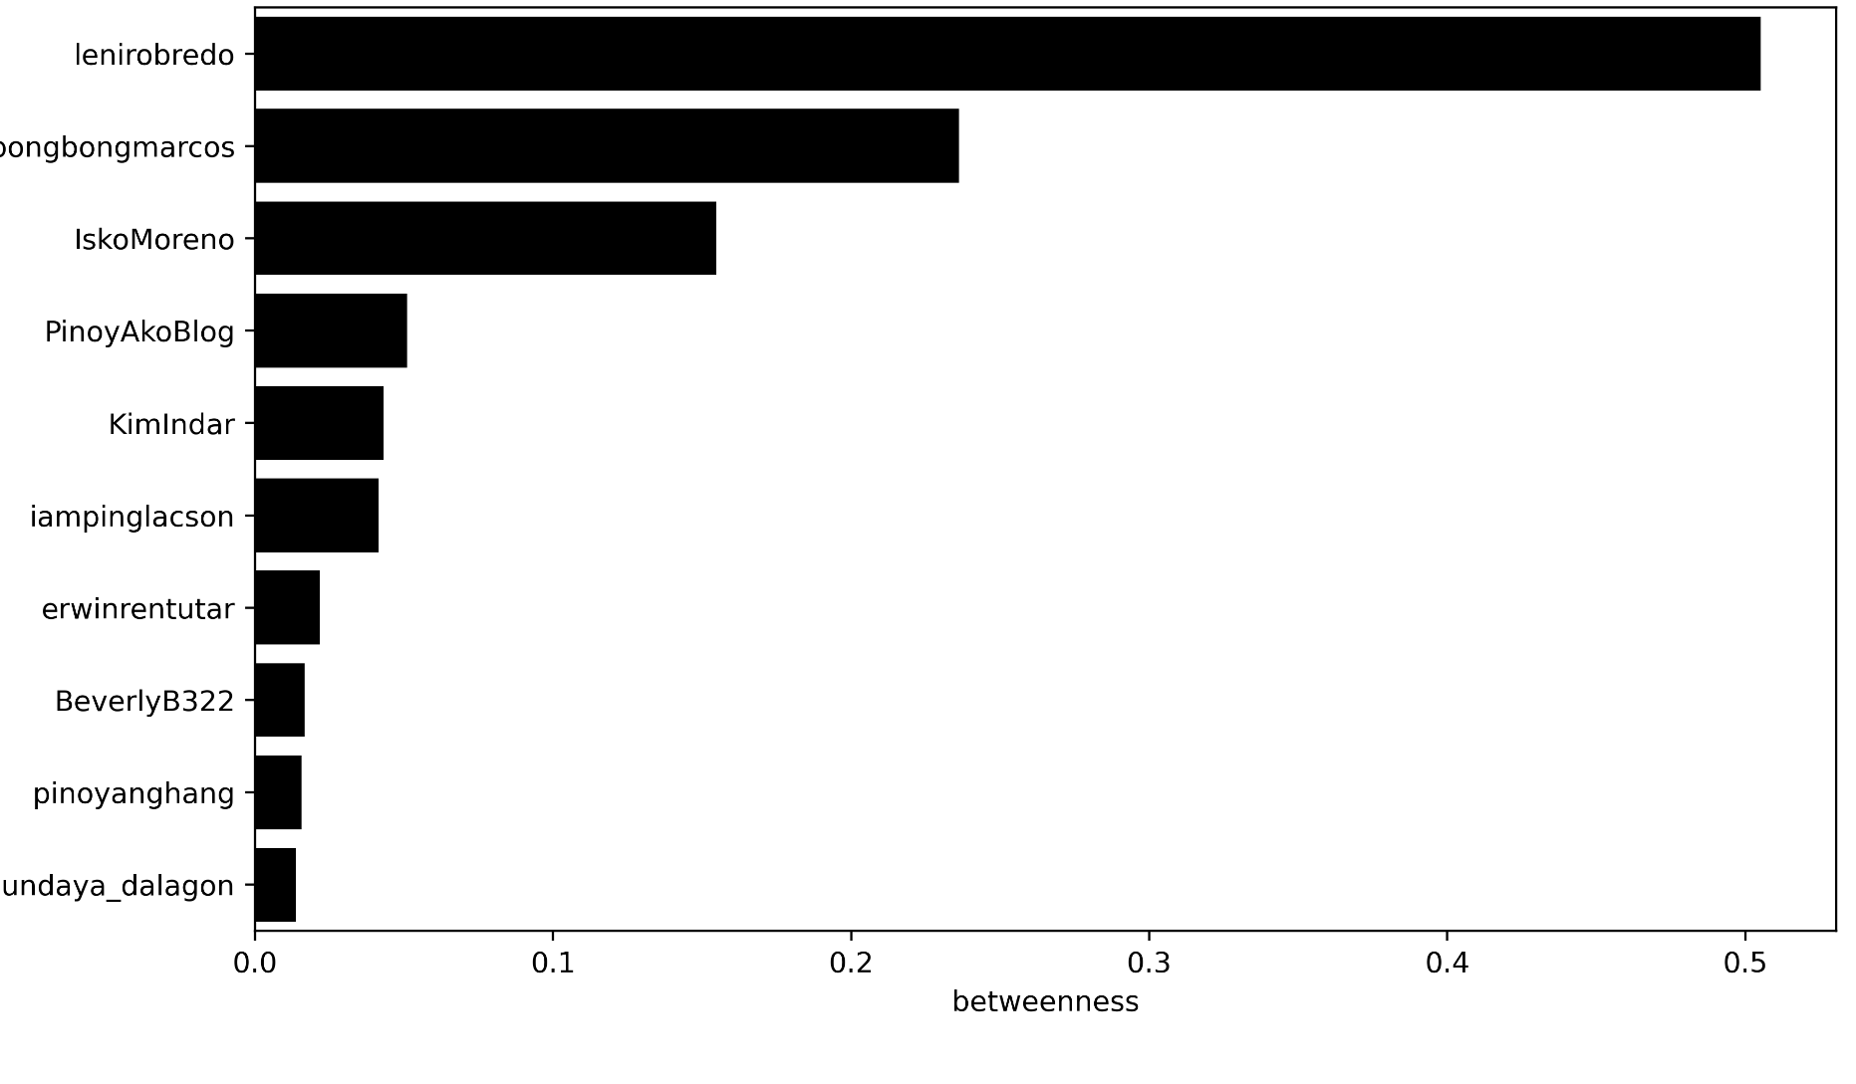
Degree
Closeness
Betweenness
Notes:
Based on the results of the network metrics:
We can see an introduction of micro influencers such as pinoyakoblog, having a high degree of closeness

Slide 34
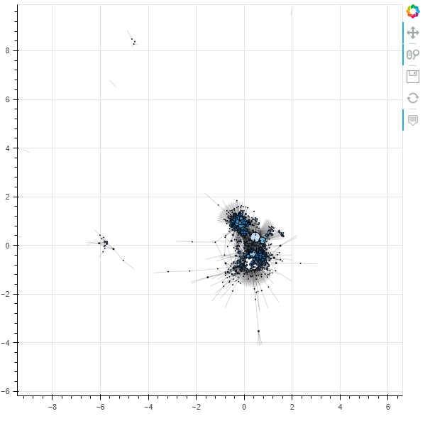
Twitter Network Generated with Outliers
 | Degree | Betweenness | Modularity class | Closeness
Leni Robredo | 436 | 0.505263 | 0.0 | 0.551088
Bong bong Marcos | 329 | 0.236248 | 2.0 | 0.455182
Isko Moreno | 225 | 0.154704 | 1.0 | 0.427972
Ping Lacson | 91 | 0.041353 | 0.0 | 0.358429

Slide 35
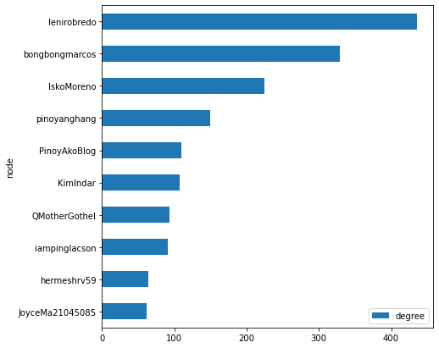
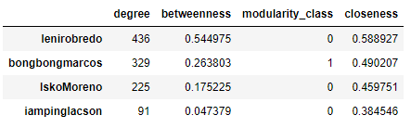
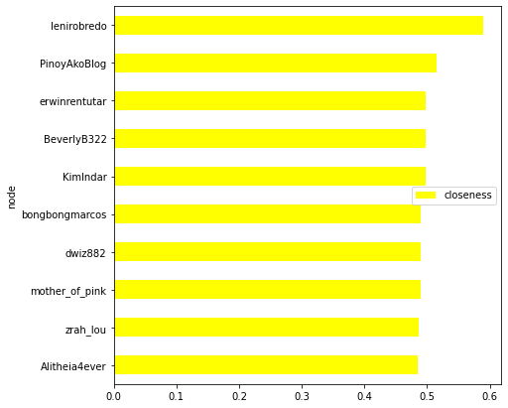
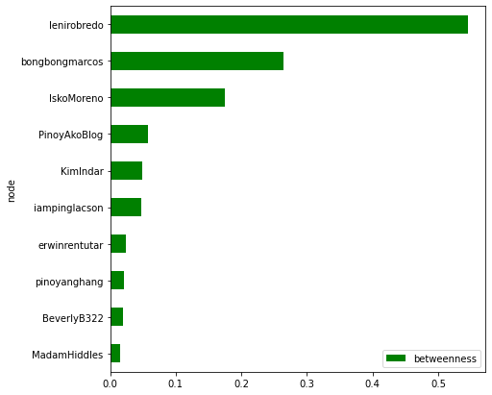
Measures of Centrality with Girven-Newman Community Detection without outliers

Slide 36
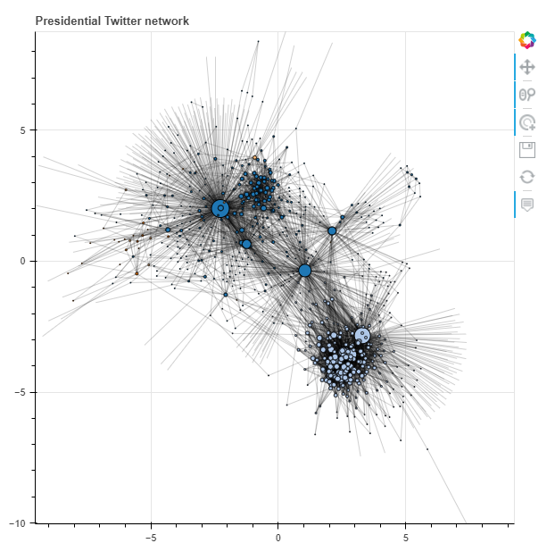
Measures of Centrality with Girvan-Newman Community Detection
Assumed Number of Communities (k) = 4

Slide 37
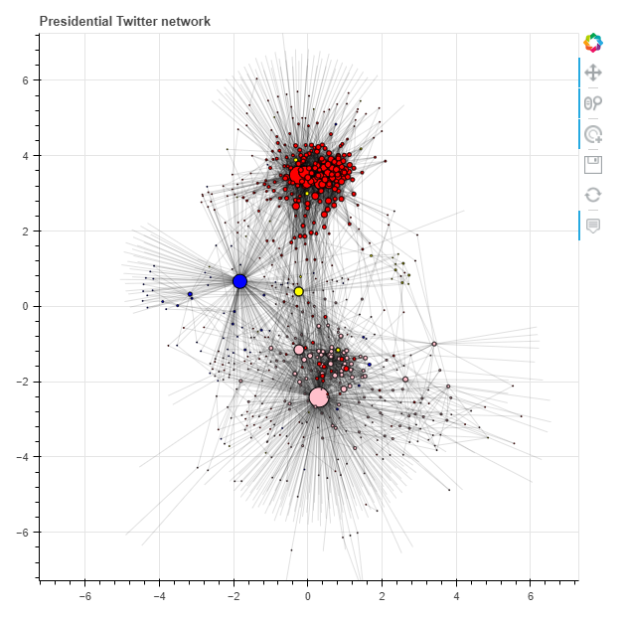
Comparing Girvan-Newman Community Detection with Communities implied from Hashtags
Using Hashtags

Slide 38
Do candidate communities stay within their respective communities?
“Some candidate communities are more receptive compared to others.”
Notes:
We aim to find out if the twitter communities of each presidential candidate of the upcoming 2022 elections only stay within their respective communities
How ?open-minded? are the supporter communities of the 2022 presidential candidates in terms of listening to opinion outside of their respective communities?

Slide 39
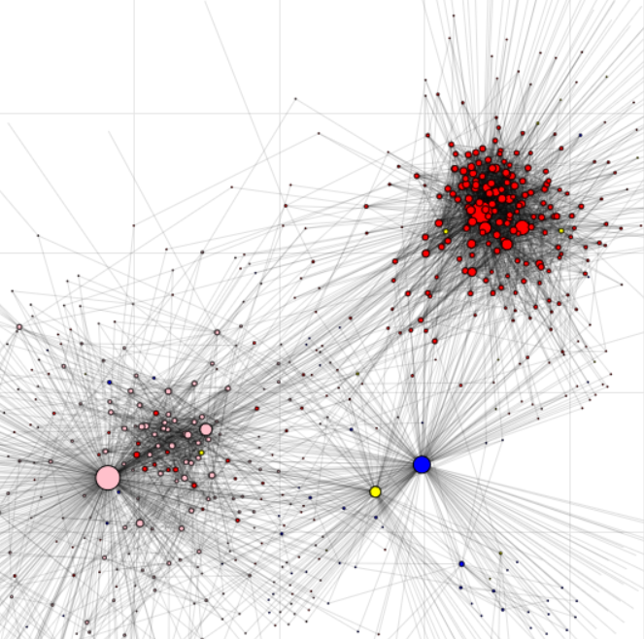
BBM and Leni supporters tend to be more receptive towards Ping and Isko.
However, Leni and BBM supporters are not as receptive to BBM and Leni respectively
Notes:
We aim to find out if the twitter communities of each presidential candidate of the upcoming 2022 elections only stay within their respective communities
How ?open-minded? are the supporter communities of the 2022 presidential candidates in terms of listening to opinion outside of their respective communities?

Slide 40
Recommendations
Notes:
Use a larger timeframe to get a bigger picture of the general discourse
Include Manny Pacquiao by refining keyword searches or use another social media platform or surveys to capture discourse
Sentiment analysis to determine affiliation of each tweet for each community influencer

Slide 41
Methodology
Action Points
Use a larger time frame to get a bigger picture of the general discourse
Include Manny Pacquiao by refining keyword searches or use another social media platform or surveys to capture discourse
Sentiment analysis to accurately determine affiliation of each tweet for each community influencer
Investigate the legitimacy of recent accounts created especially during this period
Include other social media
Premium Twitter API
Subscribe to other politicians not as a form of support but to hear opposing opinions
Be skeptical of people regarding their opinions - always ask why and figure out their driving motivations
Notes:
We aim to find out if the twitter communities of each presidential candidate of the upcoming 2022 elections only stay within their respective communities
How ?open-minded? are the supporter communities of the 2022 presidential candidates in terms of listening to opinion outside of their respective communities?

Slide 42
Thank You!
Notes:
Use a larger timeframe to get a bigger picture of the general discourse
Include Manny Pacquiao by refining keyword searches or use another social media platform or surveys to capture discourse
Sentiment analysis to determine affiliation of each tweet for each community influencer

Slide 43
#Halalan2022

Slide 44
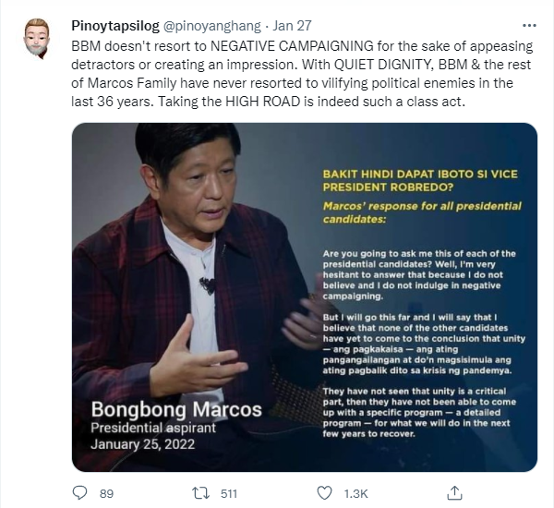
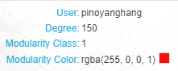
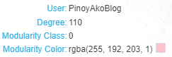
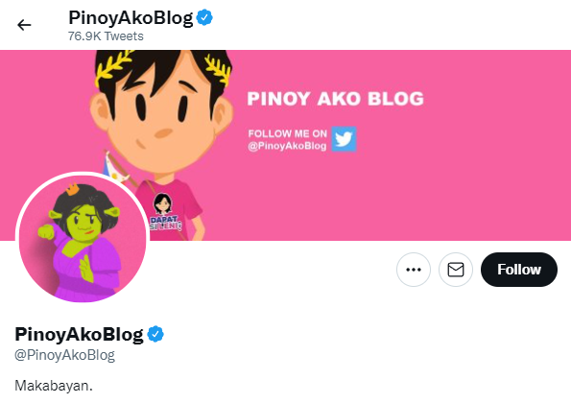
Sense Check

Slide 45
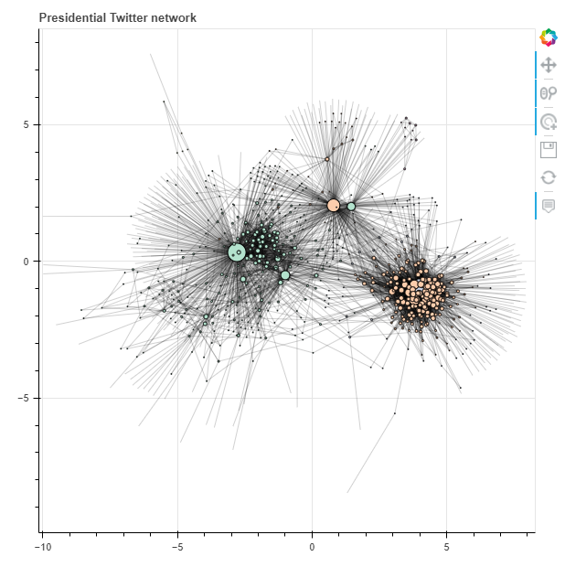
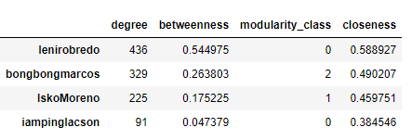
Measures of Centrality with Greedy Algorithm

